Slide 2
A Loving People
A Righteous People

Slide 3
A Righteous People
Philippians 1:11 Filled with the fruit of righteousness that comes through Jesus Christ, to the glory and praise of God.

Slide 4
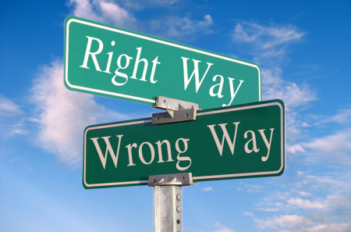
A Righteous People

Slide 5
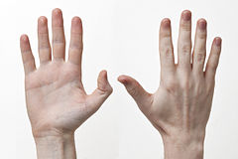
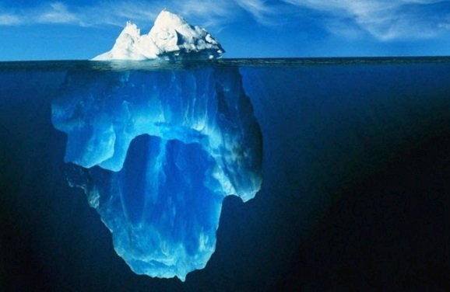
Attention
Action
Attitude

Slide 6
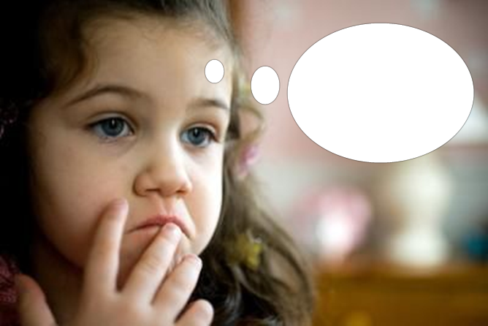
Attention
A Righteous People

Slide 7
Attention
A Righteous People
Romans 2:5
But in accordance with your hardness and your impenitent heart you are treasuring up for yourself wrath in the day of wrath and revelation of the righteous judgment of God.

Slide 8
Attention
A Righteous People
Philippians 4:8
Finally, brethren, whatever things are true, …noble, …just, …pure, …lovely, …of good report, if there is any virtue and if there is anything praiseworthy—meditate on these things.

Slide 9
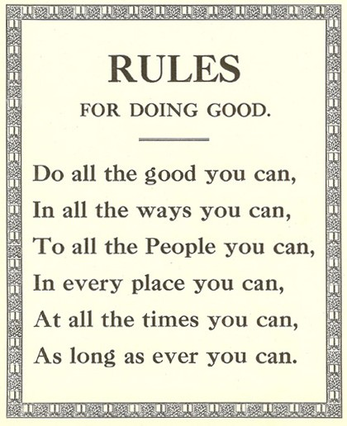
Action
A Righteous People

Slide 10
Action
A Righteous People
1 John 3:7 Little children, let no one deceive you. He who practices righteousness is righteous, just as He is righteous.

Slide 11
Action
A Righteous People
1 Peter 3:14 But even if you should suffer for righteousness' sake, you are blessed. And do not be afraid of their threats, nor be troubled.

Slide 12
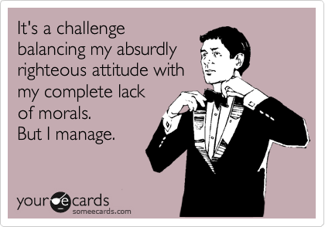
Attitude
A Righteous People

Slide 13
Attitude
A Righteous People
2 Corinthians 5:21 For He made Him who knew no sin to be sin for us, that we might become the righteousness of God in Him.

Slide 14
Attitude
A Righteous People
Titus 3:5 Not by works of righteousness which we have done, but according to His mercy He saved us, through the washing of regeneration and renewing of the Holy Spirit,

